Slide 1

PANIMALAR ENGINEERING COLLEGE AN AUTONOMOUS INSTITUTION DEPARTMENT OF INFORMATION TECHNOLOGY
IT8611 Mini Project Project Review
III year/VI sem
Fetal Congenital Heart Defect Detection Using Machine Learning
Team Members
211420205046 - ESTHER JASMINE C
211420205015 - ANGELIN PABITHA N S
211420205066 - JAYABHARGAVI B

Slide 2

ML IN HEALTH
DETECTION OF FETAL CONGENITAL HEART DEFECT

Slide 3

TEAM DETAILS
ESTHER JASMINE C
ANGELIN PABITHA N.S
JAYABHARGAVI B

Slide 4
CONGENITAL HEART DEFECT
"Congenital heart disease" refers to a broad category of birth disorders that impair the heart's ability to function normally. "Congenital" indicates that the condition has existed from birth. The structure and function of a baby's heart can be impacted by CHDs, which are present at birth.
These may have an impact on how blood circulates through the heart and throughout the body. Mild CHDs (such as a little hole in the heart) and severe CHDs are also possible (such as missing or poorly formed parts of the heart).

Slide 5
PROBLEM STATEMENT
DETECTION OF FETAL CONGENITAL HEARTH DEFECT(CHD)
In theory over 90% of complex congenital heart disease is diagnosable.
Whereas in practice the fetal diagnosis rate for CHD is only 30-50%.
Main reason for this startling diagnosis gap is inadequate/uneven expertise in interpreting fetal cardiac images.
Due to diagnostic challenge presented by a small and fast-beating fetal heart.

Slide 6
SOLUTION PROPOSED
We thought of constructing a model which would be able to locate heart and classify different views of fetal heart from a given temporal sequence/ video.
And a tool also which will bookmark all the predicted views of fetal anatomy in real time, hence reduced human reliance.

Slide 7
REQUIREMENTS
Environment
Python 3.6
Python 3.6 Libraries
Keras
Tensorflow
Scikit learn
Pandas
Numpy
livelossplot

Slide 8
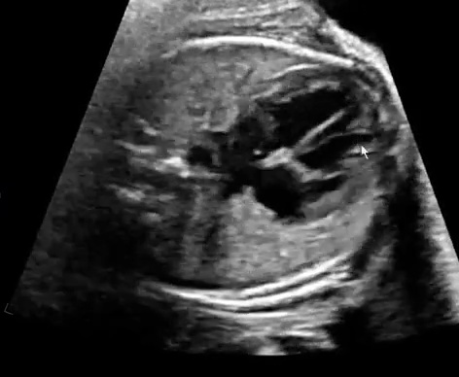
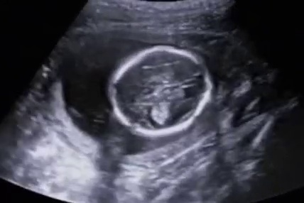
DATA SAMPLES
Heart Image
Non-Heart Image

Slide 9
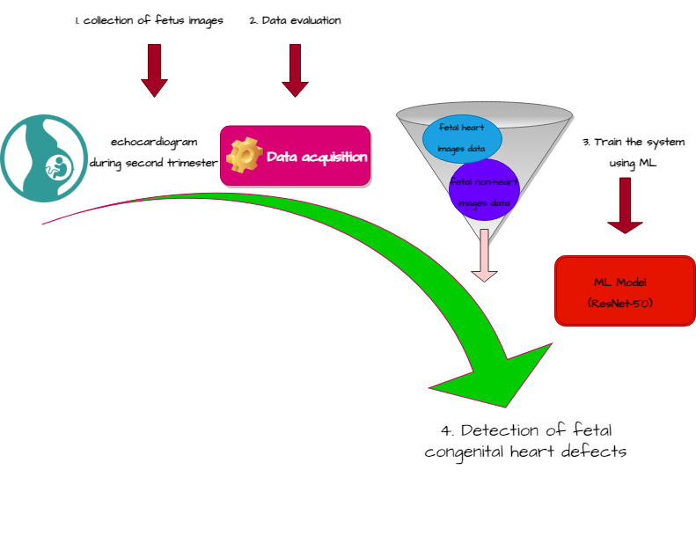
SOLUTION APPROACH
Feature Engineering
Data Cleaning
Model training
Algorithm selection
Hyper parameter tuning
Model Evaluation
Validation Graphs
Training iterations
Normalization
Regularization

Slide 10
Why Residual Networks (ResNet-50) ?
Deep convolution neural networks have led to a series of breakthroughs for image classification.
Hence there is a trend to go more deeper.
But as we go deeper there is a degradation problem causing accuracy to get saturated or decrease even.
One solution to this solution is Forward propagation of feature from previous layers directly as identity function (Residual propagation).
Hence Residual Propagation makes networks easier to optimize, and can gain accuracy from considerably increased depth.
Hence ResNet is used.

Slide 11
Machine learning for fetal heart diagnosis
Machine learning algorithms are used to detect fetal CHD, and some systems also use deep learning. Supervised knowledge is needed to classify the vast data. We are supposed to train our system to classify the fetal heart from the given image data.
A fetal echocardiogram includes the 2D cardiac image, assessment of the blood vessel, and the blood flow in the formed arteries recorded. Comparing all the machine learning algorithms, random forest(RF) provides increased sensitivity in detecting CHD.

Slide 12
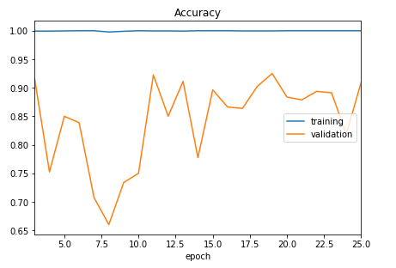
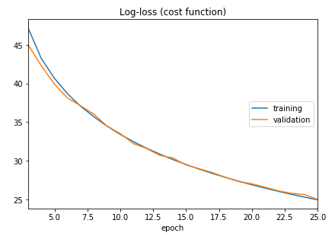
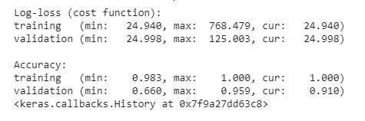
RESULTS

Slide 13
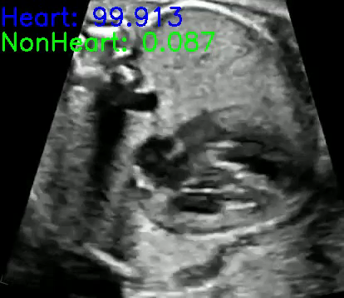
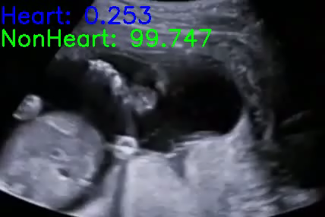
Demo of Tool Prototype
Heart Image
Non-Heart Image

Slide 14
Business Model & Impact
Time taken for Fetal echocardiography is very long and overall accuracy of congenital heart defect detection is of 30-50 percent only causing significant morbidity and mortality after birth.
So with the proposed solution we intend to reduce the time required for fetal echocardiography by 60-70 percent and also increase the CHD defect detection rate.

Slide 15
REFERENCES
AUTOMATED CHARACTERIZATION OF THE FETAL HEART IN ULTRASOUND IMAGESUSING FULLY CONVOLUTIONAL NEURAL NETWORK Vaanathi Sundaresana, Christopher P. Bridgea, Christos Ioannoub, J. Alison Noblea.
Early Prediction of Heart Diseases Using Data Mining Techniques Caribbean Journal of Science and Technology, Vol. 1, 208-217, 2013.
A. Krizhevsky, I. Sutskever, and G. Hinton. Imagenet classiﬁcation with deep convolutional neural networks. In NIPS, 2012.

